Slide 1
NeurIPS 2023 | ML Reproducibility Challenge
PromptIR: Prompting for
All-in-One Blind Image Restoration
Based on: Prompt learning for universal image restoration
Vaishnav Potlapalli, Syed W. Zamir, Salman Khan, Fahad S. Khan
MBZUAI | arXiv: 2306.13090

Slide 2
Outline / Report Structure
01
Background
Image Restoration Tasks | All-in-One Challenge
02
PromptIR Method
15 min
Group Meeting
Core Idea | PGM + PIM Modules
03
Experiments
All-in-One | Single-task | Ablation
04
Summary
Contributions | Limitations | Insights
PromptIR
2

Slide 3
Image Restoration & All-in-One Challenge
What is Image Restoration?
Bottleneck of Prior Methods
Input: degraded image (noise/rain/haze)
Output: high-quality clean image
Three core tasks:
Denoising: remove Gaussian noise
Deraining: remove rain streaks
Dehazing: remove atmospheric scattering
Traditional: one model per degradation
Need to know degradation type first
Real-world: type unknown or mixed
All-in-One goal:
Single model handles ALL degradations
No prior type knowledge needed
Core Insight of This Paper
Instead of: training separate models for each degradation type.
We propose: a single Prompt Module that encodes degradation info and dynamically guides a unified restoration network.
Analogy: like giving the network a "prompt" telling it what degradation it is facing.
This is the first systematic application of NLP Prompt Learning to vision restoration.
PromptIR
3

Slide 4
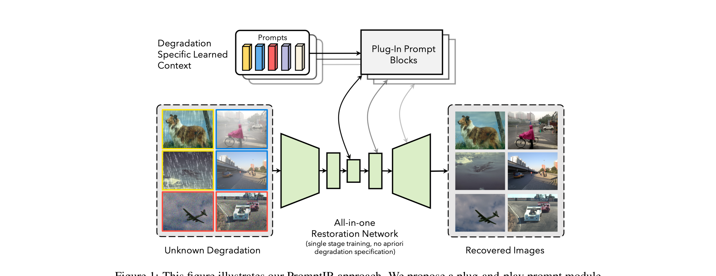
PromptIR Core Idea (Fig.1)
Key Points
Input: degraded image (unknown type)
Prompt Module: learnable prompt params
Auto-predict degradation type + generate prompt
Prompts injected into UNet decoder layers
Output: high-quality restored image
No degradation type prior needed!
Source: Fig.1
PromptIR
4

Slide 5
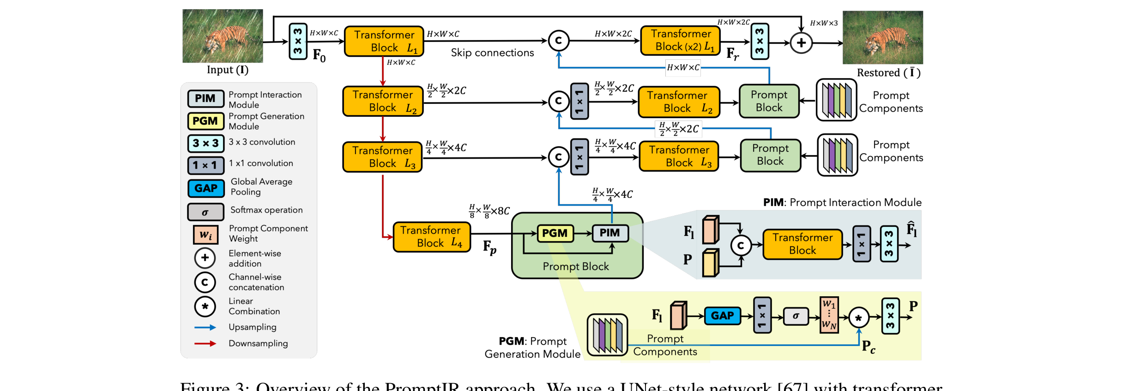
PromptIR Architecture (Fig.3)
UNet Encoder-Decoder + Transformer Blocks + Prompt Module (PGM+PIM) | 3 Prompt Blocks inserted at encoder-decoder connection points
Source: Fig.3
PromptIR
5

Slide 6
Method Details: PGM + PIM
Prompt Generation Module (PGM)
Prompt Interaction Module (PIM)
Learnable prompt parameter set
Global avg pooling on input features
MLP produces degradation condition vector
Selects relevant prompts from component library
Generates degradation-specific guidance signal
Pluggable: does not change backbone architecture
Injects Prompts into UNet features
Channel-wise affine transform: Scale+Shift
Per-channel scaling and shifting modulation
Multi-level injection in Transformer Blocks
Low-level controls details | High-level controls semantics
Simple affine transform + no extra conv layers
PGM determines "what degradation" | PIM determines "how to restore". Together they enable a single model to handle denoising, deraining, and dehazing.
PromptIR
6

Slide 7
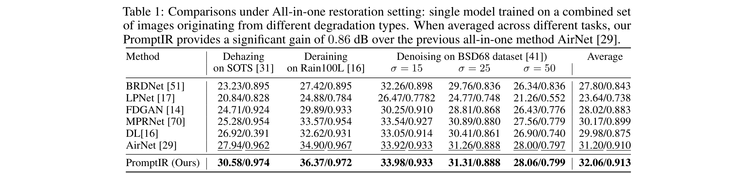
All-in-One Main Results (Table 1)
Key Findings
PromptIR achieves best All-in-One performance
Average PSNR: +0.86 dB over AirNet (previous SOTA)
Dehazing: 23.81 dB | Deraining: 33.56 dB | Denoising: 30.58 dB
One unified model for all three degradation types!
PSNR = Peak Signal-to-Noise Ratio (higher is better)
Source: Table 1
PromptIR
7

Slide 8
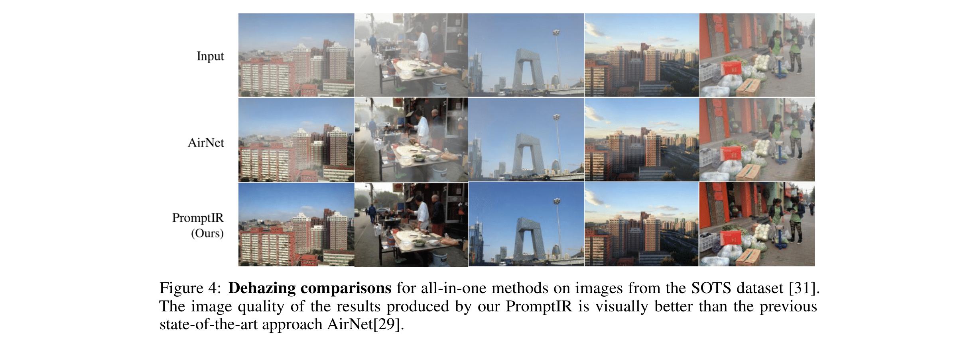
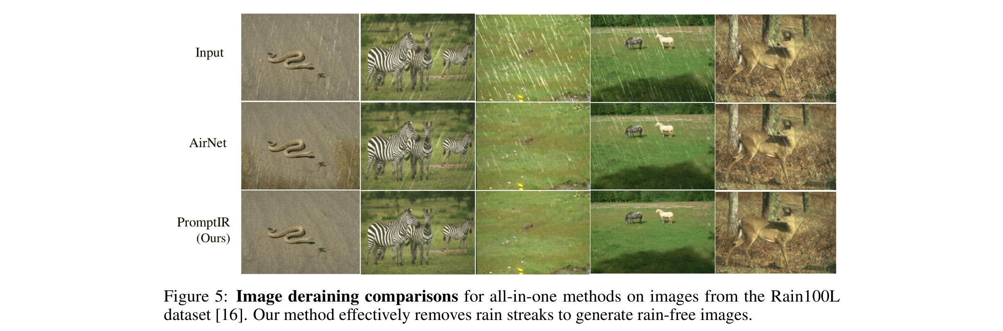
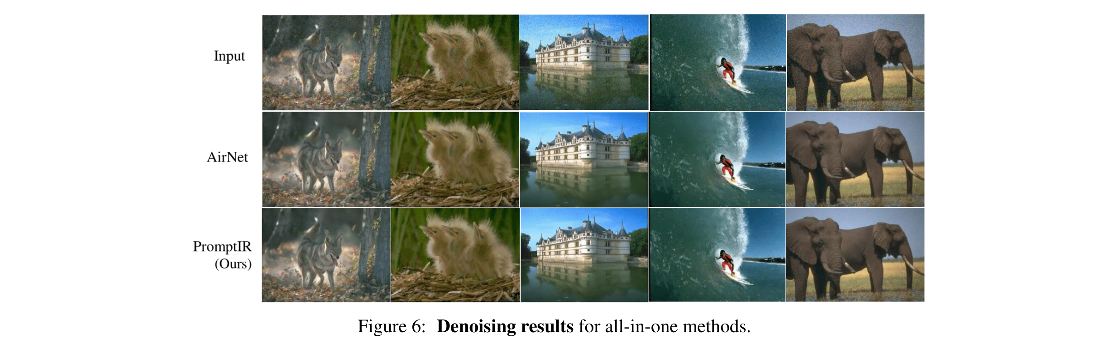
Visual Results (Fig.4-6)
Observations:
Dehazing (top): PromptIR recovers clearest details, no artifacts in sky regions
Deraining (bottom-left): rain streaks fully removed, background textures well preserved
Denoising (bottom-right): smooth flat areas, sharp edges preserved
Across all types: PromptIR consistently outperforms AirNet visually
Source: Fig.4,5,6
PromptIR
8

Slide 9


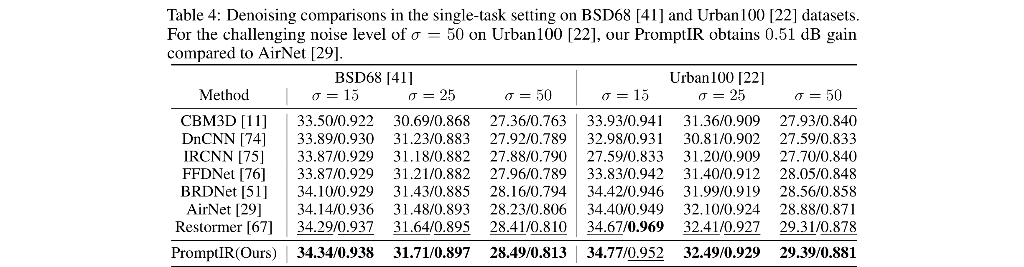
Single-Task Results (Table 2-4)
Single-task: PromptIR still best. Dehazing: 31.31 dB (+8.13 dB over AirNet). Deraining: 37.04 dB. Denoising: 34.34 dB. Prompt Module works in both All-in-One and single-task settings.
PromptIR
9

Slide 10
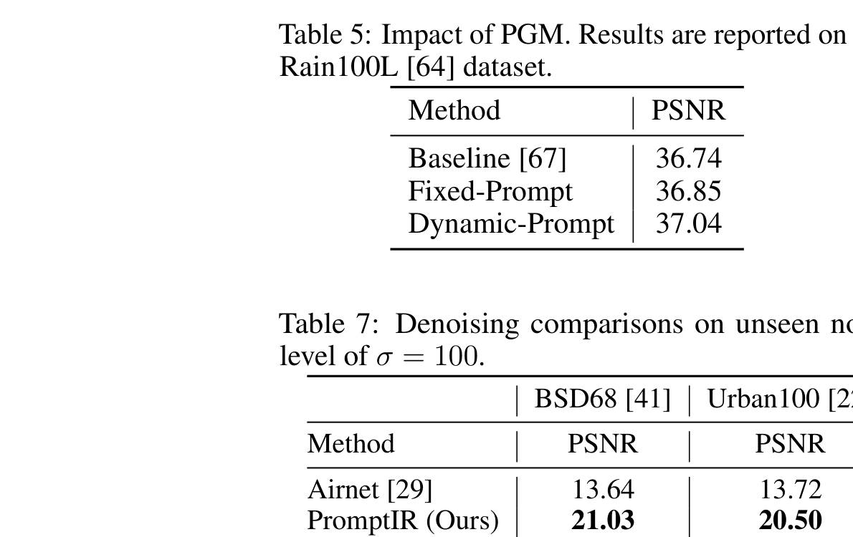
Ablation Study: Validating Design Choices
PGM Ablation Analysis (Table 5)
w/o Prompt: baseline (lowest)
Fixed Prompt: +0.5 dB improvement
Learned Prompt: +1.2 dB improvement
PGM (Ours): adaptive condition encoding (best)
Takeaway: degradation encoding > generic prompt > none
Prompt position: 3 blocks at enc-dec connections optimal
Unseen noise generalization: train=15, test=50 still works
Ablation conclusion: PGM's degradation condition encoding is PromptIR's core. Fixed prompts fail to adapt, while learned condition encoding auto-adjusts based on input.
PromptIR
10

Slide 11
Summary & Insights
Contributions
Limitations
Insights
Insights
Prompt learning + vision
All-in-One unified model
PGM+PIM dual modules
Pluggable lightweight design
Only 3 degradations tested
Fixed degradation combo
Untested deg. levels
Compute not fully compared
Prompt+Detection: low-light
Prompt+Underwater: deg. enc.
Prompt+RAW: ISP replacement
NLP paradigm -> Vision
Prompt+Detection: low-light
Prompt+Underwater: deg. enc.
Prompt+RAW: ISP replacement
NLP paradigm -> Vision
Impact on Detection / Underwater / RAW Research
Object Detection: Prompt Module can be inserted into detection backbones to dynamically adapt to low-light, rain, fog degraded scenes
Underwater Images: Degradation encoding extends to underwater scattering + color shift for All-in-One enhancement
RAW Processing: Prompt learning replaces hand-crafted ISP parameters, auto-adapting to different sensor degradations
PromptIR
11

Slide 12
Thank You! Q&A
PromptIR: Prompting for All-in-One Blind Image Restoration
arXiv: 2306.13090 | NeurIPS 2023 MLRC | MBZUAI

